Slide 1
MySaskHealthRecord
Open Clinical Documents
Overview
November 2023

Slide 2
Agenda
Background and Governance
Current State & Benefits
Upcoming Enhancements
Next Steps
Questions

Slide 3
Background and Governance

Slide 4
What is MySaskHealthRecords (MSHR)?
MySaskHealthRecord is a free and secure website enabling patients to view their Health records, and manage their own health information
Launched in 2018, MySaskHealthRecord is currently available to patients 14 years and older. Parents and caregivers can also access health records for children and dependents under 14. Current users ~ 677K+
MySaskHealthRecord allows patients to:
View their Lab Results, Medical Imaging Reports, Immunization History, Prescription History, Clinical Visit History, and Saskatchewan Cancer Agency Clinical Documents
Track and self document their health information
The Ministry of Health has included the mandate of open clinical documents from the eHRViewer to MSHR in its 2022-23 strategic priorities.

Slide 5
MySaskHealthRecord History
Goal: Empower patients with information to become active participants in their care
May 2023
SCA Open Clinical Documents Pilot Launch
MSHR Mobile App Launch
2022
Open Clinical Documents Project
Planning
2020: Released Covid-19 test results; Proof of Vaccinations Certificate
2021-Present: Additional features and data
2015: Partnered with Telus Health to build portal
2018: Launched Pilot
(1000 users)
2019: Approval to expand
Notes:
Gord

Slide 6
MySaskHealthRecord Governance
DM/CEO Council
MySaskHealthRecord Steering Committee
Patient Family Partners
SHA Digital Health Executive Director
SHA Senior Medical Information Officer
SHA Physician Executive
SMA President
Ministry of Health Executive Director
SCA Physician Executive
3sH VP IM and CIO
eHS VP Programs and Technology
eHS Director Citizen & Partnership Programs
eHS Manager Citizen Services
Steering Committee
MySaskHealthRecord Working Group
SHA Family Medicine Dept.
SHA Nurse Practitioner
SHA Senior Medical Information Officer
SHA Physician – Surgery Dept.
SCA Radiation Oncologists (2)
SCA Medical Oncologist
Provincial Pharmacy Representative
3sH Physician Consultant
Patient Family Partners (2)
Ministry of Health Informatics
eHS Director Citizen & Partnership Programs
eHS Manager Citizen Services
3sH Director Provincial Dictation & Transcription Services
Subject Matter Experts as required
Working Group

Slide 7
MySaskHealthRecord Support Task Teams
Open Clinical Documents - Corrections Task Team
Open Clinical Documents – Sensitive Information Task Team
Patient Family Partner Focus Group
Open Clinical Documents – Change Management & Communications Task Team
Operations - eHS Citizen Services

Slide 8
Current State & Benefits
MySaskHealthRecord Benefits | Results to Patients | Results to Health Care Providers
Increased access to relevant medical records | Improves patient engagement and encourages active participation | Active participation leading to improved health management
Increased ability to share records with health care providers and family members | Promotes transition and continuity of care | Improves continuity of care to make informed decisions Decreases time to access relevant patient medical records to support continuity of care
Increased ability to track personal medical information and appointments | Empowers patients to take an active role in their health management | Active participating leading to improved health management

Slide 9
Patient Feedback: Highlights
In the 2023 MySaskHealthRecord user survey:
44% of users indicated they share their record with family or others who support their health care journey.
78% of users indicated they have noticed an improvement in the understanding of their health.
70% indicated and they are better prepared for their appointments and feel involved in managing their health in partnership with their health care providers.
43% of users indicated their stress levels have improved as a result of having access to their own information in MSHR.
Data points improved or remained steady between 2020 and 2023 surveys
Source: 2020 & 2023 MySaskHealthRecord Surveys
Notes:
Source: SaskHealthRecord User Survey Report v1.5 (9Mar2023).pptx (ehealthsask.ca)

Slide 10
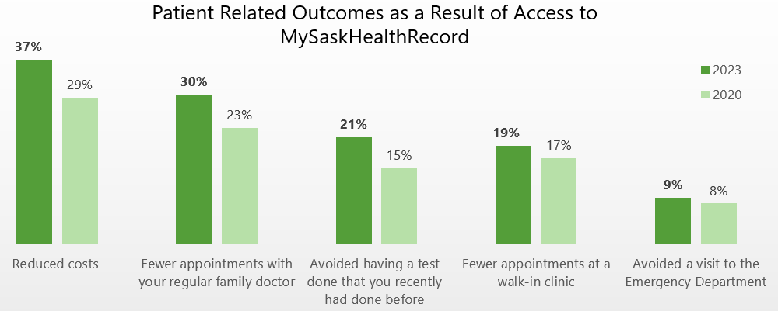
Patient Feedback: Outcomes
Source: 2020 & 2023 MySaskHealthRecord Surveys
See Appendix 1 for additional results
Notes:
Source: MySaskHealthRecord User Survey Report v1.5 (9Mar2023).pptx (ehealthsask.ca)

Slide 11
Upcoming Enhancements: Open Clinical Documents

Slide 12
Open clinical documents: Implementation approach
Phased implementation:
start small, not retroactive
Learn from other jurisdictions
Pilot with SCA
Formation of working groups to manage risks and change:
Corrections team
Sensitive information team
Change management and communication (CMC) team

Slide 13
Open clinical documents: Scope
In scope (2023-24):
Documents generated in the SHA and SCA
Reports already in the eHRViewer:
Operative/Procedure
Discharge summaries/transfers
Consults
Review/Follow ups
Hospital Admission
Consults
History/Physicals

Slide 14
Implementation Timelines
Phase | Timeframe
Phase 1 – SCA reports | May 1 2023
 | Estimated Timeframe*
Phase 2 – SHA reports | Q2-Q4 2023/2024
* Timeline dependent on MSHR governance approvals and organizational readiness.

Slide 15
Open Clinical Documents SCA Pilot
All SCA documents in the eHRViewer have been released
SCA Reports | Timeframe
Iteration 1 – Discharge Summaries Iteration 2 – Consults and Referrals Iteration 3 – Progress Notes | May 5, 2023 May 10, 2023 May 31, 2023
Notes:
Shain
People are accessing the clinical docs widget on MSHR an average of 1850 times/day since May 1

Slide 16
SHA Implementation: Open Clinical Document Type
Reports already in the eHRViewer:
Document Type | ~# of Docs/month | Proposed Order
Diagnostic Reports | 1084 | 1 (Nov 2023)
Decision Items
Operative Reports | 9958 | 2 (Winter)
Outpatient Reports | 5733 | 3 (Winter)
Discharge Summary/Transfer | 7657 | 4 (Winter)
Consults | 9758 | 5 (Winter)
History & Physical | 1029 | 6 (Winter)
Notes:
Shain
Examples of the most common types are documents already in the ehrviewer are Operative Procedure Reports and Consults/Referrals which make up the largest volume, as well as Discharge Summaries and Outpatient notes.
average # of new / month
Admission history and physicals
Discharge summaries
Consults
Dx reports
Progress reports
Operative notes
Outpatient reports
Sask Cancer Agency
To note:
LOINC code is how the documents are filtered
SCM uses differing naming standards so results are not included

Slide 17
Most Frequently Generated SHA Diagnostic Reports
Holter Monitors
Sleep Studies
Exercise Tolerance Tests
Pulmonary Function Tests
ECG
Stress Tests
EEG
Esophageal manometry
Ambulatory reflux monitoring and pH impedance

Slide 18
Sensitive Information – Privacy & Access
Proxy access to MySaskHealthRecord
~41,000 minors (under age 14) have a parent/legal guardian linked to their MySaskHealthRecord
~8,300 are age 12-13
s.56 of HIPA allows others to act on behalf of an individual in certain circumstances
For individuals under the age of 18, the legal custodian can act on behalf of the minor if:
The minor is not a “mature minor” (s.56(c))
It is not an unreasonable invasion of the minor’s privacy (s.56(d))
Refusing access to personal health information
Threat to health or safety (s.38(1)(a)) – OIPC has set a high threshold of when this can be used
Notes:
SHain

Slide 19
Next Steps

Slide 20
What you can do now
Learn about the portal. Information about MySaskHealthRecords is available here:
For providers: MySaskHealthRecord Home (ehealthsask.ca)
For the public: MySaskHealthRecord About (ehealthsask.ca)
Additional resources:
Provider Tips, Provider FAQs, and the corrections process guidelines can be found on the MySaskHealthRecord Home (ehealthsask.ca) site for providers.
Patient-centred writing/dictation tips
USA: Opennotes.org
Inform your team about MySaskHealthRecord
Provide feedback/Participate: Be part of our journey to empower patients
Contact: Diane.dolney@ehealthsask.ca or Gord.smith@ehealthsask.ca

Slide 21
Questions?
Thank you!

Slide 22
Appendix 1. 2023 MySaskHealthRecord Survey Results

Slide 25
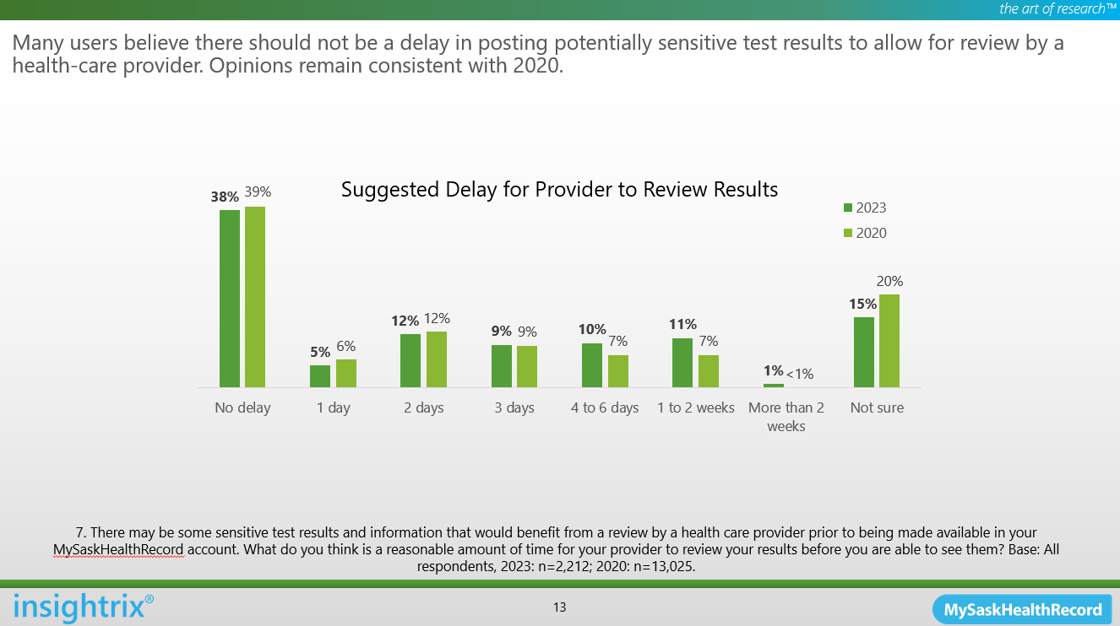

Slide 26
