Slide 1
Open Clinical Documents
Grand Rounds Webinar
Thursday, August 24, 2023 at 1730h-1900h
Co-Hosts: Drs. Susan Shaw and Joy Dobson
Guest Presenters/Panel Members: Dr. Steve O’Neill, Diane Aldridge, Alyx Larocque, Dr. Ben Maas, Judy McConnell
Notes:
Joy: Welcome to Grand Rounds. We will get underway in 2 minutes… Thank you for joining Dr. Shaw and myself tonight as we host this webinar.

Slide 2
Land Acknowledgement
We acknowledge that we work and meet on the territory covered by Treaties 2, 4, 5, 6, 7, 8 and 10, the traditional territories of the Cree, Saulteaux, Dakota, Lakota, Nakota, Stoney, and Dene, and the Homeland of the Métis/Michif. Recognizing this history and the Truth and Reconciliation Commission Calls to Action are important to our future and our efforts to close the gap in health outcomes between Indigenous and non-Indigenous peoples.
As treaty people, we pay respect to the traditional caretakers of this land.
Notes:
Joy: We acknowledge…

Slide 3
Polling Question #1
Tell us your role in the health system
Physician
Nurse/Nurse Practitioner
Health Information Professional
Patient
Other - specify

Slide 4
Outline
1735h Voice of Experience – Dr. Steve O’Neill, Harvard Medical School Faculty
1755h Voice of the SK Privacy Commissioner – Diane Aldridge and Alyx Larocque
1815h Voice of the Provider – Dr. Ben Maas, SCA
1820h Voice of the Patient - Judy McConnell, Patient Family Partner
1825h Questions and Panel Discussion
1850h Meeting Evaluation and Close
Notes:
Joy: This is an outline of the session and we plan to wrap up before 1900h.

Slide 5
Learning Objectives
Become familiar with short and long term outcomes from implementation of open clinical documents
Become familiar with HIPA legislation as applied to open clinical documents
Become familiar with local “market forces”
* Session is being recorded, and slides will be on the MySaskHealthRecord website
Notes:
Joy: The learning objectives are here. We are recording this session (Gord or Carmen this is the reminder if you needed one) and will be posting the slides after this session on the MySKHR website under the Provider section. A reminder to put your questions in the chat and we will respond there or during the interactive discussion period.

Slide 6
Conflict of Interest Disclosure for Dr. Susan Shaw
Relationships with financial sponsors:
Grants/Research Support: NONE
Speakers Bureau/Honoraria: NONE
Consulting Fees: NONE
Patents: NONE
Other: NONE

Slide 7
Conflict of Interest Disclosure for Dr. Dobson
Relationships with financial sponsors:
Grants/Research Support: NONE
Speakers Bureau/Honoraria: NONE
Consulting Fees: NONE
Patents: NONE
Other: Contracted to 3sHealth to work on MySkHR project

Slide 8
Mitigation of Bias
No one presenting today has financial ties to the software vendors that contribute to the creation of open clinical documents

Slide 9
Proposed MSHR Open Clinical Documents Implementation Timeline
SHA Go-live
Phase 2
Operative Report
Discharge Summary
Consult
Outpatient Report
History and Physical
SHA Go-live
Phase 1
Diagnostic Reports
SCA Go-live
May 2023
July 2023
Oct 2023
Early 2024
Time for evaluation and corrections processes to be confirmed
Time for sensitive document technology processes to be implemented
Scope is limited to documents in the eViewer created using Varian, SCM or Fluency/3M

Slide 10
Polling question #2
Had you previously heard that SK is moving to open clinical documents?
Yes
No

Slide 11
Voice of Experience – Dr. Steve O’Neill, JD
Steve O'Neill is Faculty in the Center of Bioethics at Harvard Medical School where he has taught for over 40 years.
He is the OpenNotes specialist in Behavioral/Mental Health, and began the first ever program in making therapist notes readily available to patients through their personal computers in 2014.
He is especially interested in how the transparency of open note writing can foster greater trust and partnership, and contribute to de-stigmatizing mental illness and behavioral health.
Notes:
Joy: I would like to introduce our first speaker…. Dr. Steve O’Neill

Slide 12
Conflict of Interest Disclosure for Dr. O’Neill
Relationships with financial sponsors:
Grants/Research Support: NONE
Speakers Bureau/Honoraria: NONE
Consulting Fees: NONE
Patents: NONE
Other: NONE

Slide 13
Sharing Our Clinical Notes Directly with Our Patients: OpenNotes & Health Care Equity
Steve O’Neill, LICSW, BCD, JD
Social Work Manager, OpenNotes Program
Associate Director of Ethics (retired)
Beth Israel Deaconess Medical Center
Teaching Faculty, Center for Bioethics
Department of Social Medicine
Harvard Medical School
Professor and Research Associate
Simmons University School of Social Work
Saskatchewan, Canada
August, 2023

Slide 14
Relevant Beth Israel Deaconess Medical Center History
First Electronic Health Record (1985)
Ethics Note Sharing Policy (25 years)
Sharing Notes in Mental Health (35+ years)
OpenNotes started within ambulatory primary care (2010); All specialties, including mental health, fully opened in 2013-14
Culture of Transparency and Trust
-Apology and Disclosure
-Preventable Harm Initiative

Slide 15
Underlying Values
Patient Autonomy……….Undue Autonomy
Professional Autonomy/Integrity…….Paternalism
Parental Autonomy
Beneficence & Non-Maleficence
Trust, Loyalty, Fidelity
Privacy/Confidentiality

Slide 16
Who Do We Write Note For?
Our Patients, as if sitting on your shoulder
Cross-coverage, especially urgent/emergency care
Professional Standard Obligations, including legal/risk management
3rd party (Disability Insurance, Workers Compensation, etc) as applicable
Ourselves

Slide 17
HEALTH CARE DISPARITY: BIAS AND STIGMA
70/30 Rule
Delivery of Difficult News ~ 70+% with solid metastatic cancer unaware of chemo’s palliative intent
Weeks et al., “Patients’ Expectations about Effects of Chemotherapy for Advanced Cancer,” NEJM 2012

Slide 18
21st Century Cures Act
Effective April, 2021 across the USA
Requires Secure Direct Patient Access to their Electronic Medical
Forbids “Information Blocking”!
Exceptions to Blocking: Substantial/Physical Harm; Privacy; Content/Manner
Prior to Cures Act, already 55 Million USA persons had OpenNotes for better than 3 years (25% included mental health notes)

Slide 19
How Can Sharing Clinical Notes Help Patients?
Demonstrates respect/reduces stigma
Empowering patients
Organizing care and tracking progress
Providing a tool for behavior change
Enhancing trust and the therapeutic relationship
Making care safer
Potential for reducing workload
Source: https://www.opennotes.org/tools-resources/for-health-care-providers/mental-health/

Slide 20
OpenNotes Research
Would OpenNotes help patients become more engaged in their care?
Would OpenNotes be the straw that breaks the clinician’s back?
After 1 year, would patients and clinicians want to continue?
Source: https://www.opennotes.org/tools-resources/for-health-care-providers

Slide 21
Clinician Concerns
More time addressing patient questions outside of visits
Pre-Intervention = 42%
Post-Intervention = 3%
More Time writing/editing notes
Pre-Intervention = 39%
Post-Intervention = 11%
Source: T Delbanco et al Annals of Internal Medicine 2012; https://www.opennotes.org/tools-resources/for-health-care-providers

Slide 22
Clinician Concerns
Did Doctors Change The Way They Wrote Notes? Yes!
25% Mental Health
20% Substance Use
10% Obesity
Sources: T Delbanco et al Annals of Internal Medicine (2012); L Fernandez et al JGIM (2021); https://www.opennotes.org/tools-resources/for-health-care-providers

Slide 23
Clinician Concerns
None of the >250 organizations that implemented OpenNotes prior to the Cures Act reported a significant increase in visit time with patients or in e-mail traffic.
In fact, some organizations reported a decrease in e-mail, as patients are able to resolve confusion or forgetfulness by reading their notes.
Sources: Walker et al JGIM (2021); https://www.opennotes.org/tools-resources/for-health-care-providers

Slide 24
What Did We Find From a Patient Perspective??
And they…………..
- want their notes!
- are not scared stiff!
- read the notes!
- share the notes!
- report important benefits!
Source: Delbanco, Walker, et al, Ann Intern Med, 2012 ; Walker et al JMIR (2019)
https://www.opennotes.org/tools-resources/for-health-care-providers

Slide 25
What Did We Find From a Patient Perspective??
“Less educated, nonwhite, older, and Hispanic patients, and individuals who usually did not speak English at home, were those most likely to report major benefits from note reading. Nearly all respondents (22,593/22,947, 98.46%) thought Web-based access to visit notes a good idea, and 62.38% (13,427/21,525) rated this practice as very important for choosing a future provider.”
Source: Walker et al JMIR (2019)
https://www.opennotes.org/tools-resources/for-health-care-providers

Slide 26
60-78% of those taking medications reported “doing better with taking my medications
as prescribed” source: https://www.opennotes.org/tools-resources/for-health-care-providers

Slide 27
“96% of patients preferred receiving immediately released test results online even if their healthcare provider had not yet reviewed the result”
(Perspectives of Patients with Immediate Access to Test Results Through an Online Patient Portal, B Steitz et al
JAMA Netw Open. 2023)

Slide 28
What did we find??
Patients with ‘adverse effects’ tended to clarify these as having underlying concerns such as privacy or already existing issues, or misinterpreted questions when asked
Biggest issue, as in medicine, seems to be whether there is concordance between what the clinician says in session and what they write in the note
Source:
https://www.opennotes.org/tools-resources/for-health-care-providers/mental-health/

Slide 29
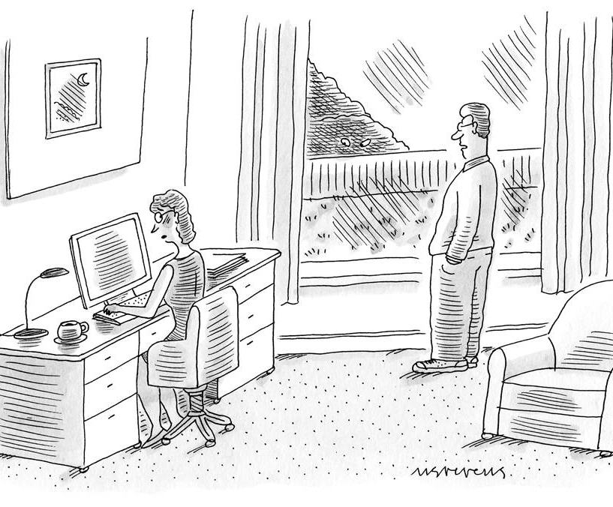
PRIVACY VS CONFIDENTIALITY
Many share with family members

Slide 30
Special Population Concerns
-Adolescents/Pediatrics
-Domestic Violence
-Child/Elder/Disabled Abuse/Neglect
Source: https://www.opennotes.org/tools-resources/for-health-care-providers/mental-health/

Slide 31
Writing Open Notes Tips
The invitation is important
Promote transparency
Use plain language and patient quotes
Engage patients in the documentation
Develop options if a patient’s access to notes may carry more risk than benefit
Discuss the diagnosis
Source: https://www.opennotes.org/tools-resources/for-health-care-providers/mental-health/

Slide 32
Thanks! Questions??
www.myopennotes.org
Contact:
myopennotes@bidmc.harvard.edu
soneill2@bidmc.harvard.edu

Slide 33
Voice of the Privacy Commissioner - Diane Aldridge
Diane has a Canadian Institute of Access and Privacy Professional (CIAPP) Professional Master’s designation (CIAPP-M) and has spent time working for different organizations including two health regions and WCB. She joined the Office of the Saskatchewan Information and Privacy Commissioner (OIPC) in 2004 and is now Deputy Privacy Commissioner, responsible for access/correction reviews and privacy investigations.
Notes:
Thank you, Steve. Our next speaker is SK’s Deputy Privacy Commissioner. Diane …

Slide 34
Alyx Larocque
Alyx Larocque is the Executive Director of Research, Policy, and Compliance at the OIPC. She graduated from the University of Regina with a bachelor’s degree in Arts (majoring in Psychology) and a bachelor’s degree in Social Work and has a master’s degree in Public Policy. She has worked for both the federal and provincial governments for the past 24 years, including several years with the Ministry of Social Services working in child protection and quality management.

Slide 35
Conflict of Interest Disclosure for Diane Aldridge
Relationships with financial sponsors:
Grants/Research Support: NONE
Speakers Bureau/Honoraria: NONE
Consulting Fees: NONE
Patents: NONE
Other: NONE

Slide 36
Conflict of Interest Disclosure for Alyx Larocque
Relationships with financial sponsors:
Grants/Research Support: NONE
Speakers Bureau/Honoraria: NONE
Consulting Fees: NONE
Patents: NONE
Other: NONE

Slide 37
Office of the Information and Privacy Commissioner
Oversight for HIPA compliance
Office of last resort
Conduct reviews and investigations
HIPA outlines rights of the individual and responsibilities of trustees, but in terms of this presentation, our focus is the right of access by the individual
HIPA’s preamble: THAT individuals shall be able to obtain access to records of their personal health information
Section 12, an individual has the right to request access to personal health information about himself or herself that is contained in a record in the custody or control of a trustee.

Slide 38
Access fundamentals
Though trustee has custody or control, it is the patient’s personal health information; trustee does not own it
Right of access by patient (includes mature minor) or their representative (see section 56 exercise of rights by others)
Supreme Court of Canada decision in 1992 noted:
Patients should have access to their medical records in all but a small number of circumstances. In the ordinary case, these records should be disclosed upon the patient's request unless there is a significant likelihood of a substantial adverse effect on her physical, mental or emotional health, or harm to a third party.
[McInerney v. MacDonald, [1992] 2 S.C.R. 138]

Slide 39
Relevant sections of HIPA
Section 38, a trustee may refuse to grant access if…
(a) in the opinion of the trustee, knowledge of the information could reasonably be expected to endanger the mental or physical health or the safety of the applicant or another person
Threshold is “could reasonably be expected” to occur. If it is fanciful or exceedingly remote, the exemption should not be invoked. Decision cannot not be made on speculation only.
“Endanger” refers to situations in which disclosure of information could threaten, or put in peril, someone’s life or physical or mental well-being, but not just causing distress.
Where a record contains information to which an applicant is refused access, the trustee shall grant access to as much of the record as can reasonably be severed … (see subsection 38(2))
Notes:
This Court in Merck Frosst adopted the “reasonable expectation of probable harm” formulation and it should be used wherever the “could reasonably be expected to” language is used in access to information statutes. As the Court in Merck Frosst emphasized, the statute tries to mark out a middle ground between that which is probable and that which is merely possible. An institution must provide evidence “well beyond” or “considerably above” a mere possibility of harm in order to reach that middle ground: paras. 197 and 199

Slide 40
To document or not to document
Everything recorded on the patient file would constitute personal health information of the individual, including what is recorded incidentally to the provision of health services
Accuracy obligations (see subsection 25(3))
Right to request amendment (see section 13)
May be requested if the person believes the personal health information contained in the record contains an error or omission
Obligation to only collect what is reasonably necessary for the purpose (data minimization principle)
To avoid complaints, emphasis on recording the objective, not subjective that is unfounded

Slide 41
To document or not to document (2)
Mandatory reporting obligations, including child abuse or neglect
Ask yourself: If you are recording issues, should you also be reporting?
See Mandatory Reporting section of College of Physicians and Surgeons of Saskatchewan’s guideline on Confidentiality of Patient Information

Slide 42
The last word
Access through the portal is not making a formal access to information request, but the right of access and a formal consideration (review) by my office could still occur if the patient is dissatisfied with the decision to deny access to all or part of the record

Slide 43
Polling Question #3
What percentage of the documents you create would meet Section 38(1) and so should not be sent to MySaskHealthRecord?
Less than 1%
Less than 10%
Less than 25%
Less than 50%
Most

Slide 44
Voice of the Provider - Dr. Ben Maas
Dr. Benjamin Maas is a Radiation Oncologist at the Saskatchewan Cancer Agency in Saskatoon and Assistant professor at the University of Saskatchewan.
He is the provincial lead for brain tumors at the cancer agency, where he treats patients with brain tumors, breast cancers, sarcomas, and other malignancies.
SCA went live with open clinical documents in May 2023
Notes:
Thank you Diane and Alyx. We now have some local experts to welcome. Ben Maas…

Slide 45
Conflict of Interest Disclosure for Dr. Ben Maas
Relationships with financial sponsors:
Grants/Research Support: NONE
Speakers Bureau/Honoraria: NONE
Consulting Fees: NONE
Patents: NONE
Other: NONE

Slide 46
Cancer Agency – Started in May – stats to July 31
No correction requests from SCA patients and providers
25% reduction in requests for paper copy
Over 17,000 SCA clinical documents sent to MSHR
No concerns reported in one on one interviews
106 SCA attendees to information sessions
Notes:
Was concern from providers initially on increase in workload through corrections, which was found to not be the case.
Key metrics identified for capturing both before and during. No concerns, continues to be strong support from SCA

Slide 47
Voice of the provider – Dr. Ben Maas
Pre-rollout concerns for physicians? Have any come true?
Added workload?
Correction requests?
Confused patients?
Personal Experience
Mindful of accuracy and wording
Starting to see patients and family who have read their notes
Positive so far – seemed to have more informed questions and good understanding of their cancer treatments.
Anecdotes from other physicians

Slide 48
Voice of the Patient - Judy McConnell
Judy is a retired RN and LTC administrator from rural Saskatchewan. She became a Patient Family Partner in 2015 to continue improving health care.
Judy has been a PFP on many committees, both locally and provincially with the SHA. She also joined 3sHealth and works with the Supply Chain Partnership Committee, the Transformational Services team, Co-Chairs the 3sHealth PFCC Council, and is on the MSHR Project team.
Notes:
Thanks, Ben. It is always good to hear from a peer. Our last guest is Judy McConnell. Judy is a retired…..

Slide 49
Conflict of Interest Disclosure for Judy McConnell
Relationships with financial sponsors:
Grants/Research Support: NONE
Speakers Bureau/Honoraria: Honoraria received from SHA and 3sHealth as a Patient Family Partner
Consulting Fees: NONE
Patents: NONE
Other: NONE

Slide 50
Voice of the Patient – Judy McConnell
Patients have been consistently asking for better access since the inception of MSHR
Being a full partner in shared decision making requires having the information
Not knowing is worse than wondering about a word or two you can’t figure out

Slide 51
Patient Related Outcomes as a Result of Access to MySaskHealthRecord
Not applicable/ never did this before anyway | 29% | 16% | 33% | 38% | 37%
9. With access to your MySaskHealthRecord information, do you believe you experienced any of the following? (Multi-select) Base: All respondents, 2023: n=2,212; 2020: n=13,025.

Slide 52
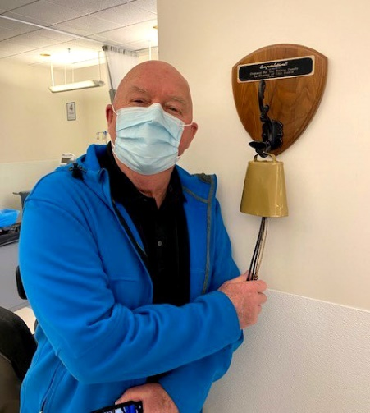
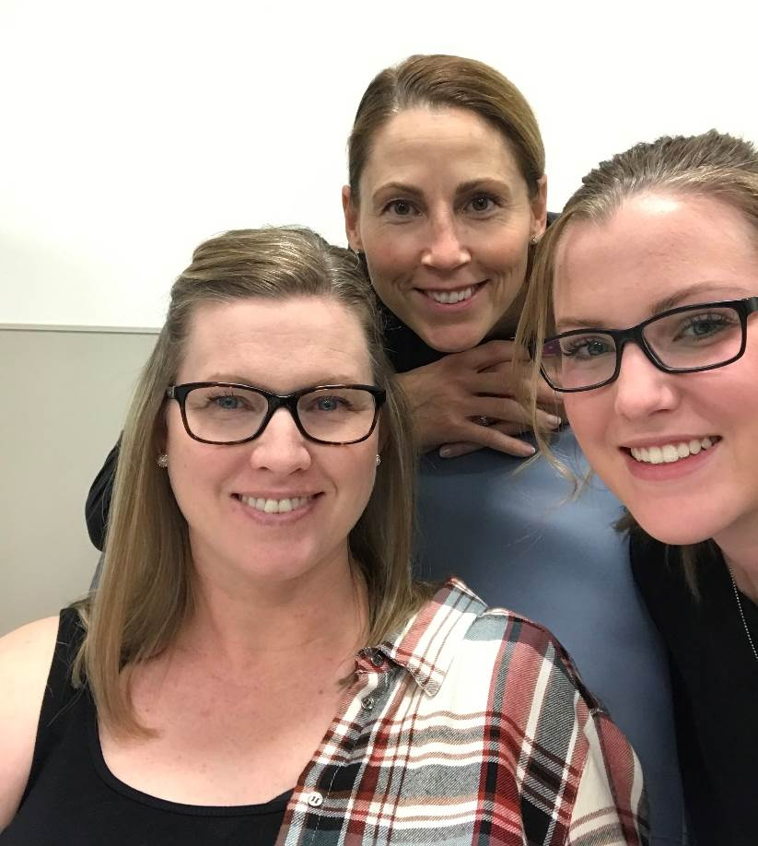
Open Clinical Documents: SCA Pilot
Ken Langston was diagnosed with Stage 4 lung cancer in December 2019. After more than three years of various treatments, he has accumulated an overwhelming amount of information about his diagnosis, treatments, and overall health—enough to fill a large binder. Since his medications and treatment plan changed so much during that time, he says it was difficult to remember the different medications, when they were prescribed, the dosages and other instructions.
“This has caused me considerable anxiety,” said Ken. “If the doctor’s notes had been easily available in MySaskHealthRecord during my treatments, I wouldn’t have had to search through all of my notes and papers to confirm that I was following doctor’s order. That convenience would have reduced my stress and anxiety and allowed me to concentrate on my treatment and healing.”
Trenna Derdall, who was diagnosed with breast cancer in October 2018, was pleased to hear the news about the addition of more information in MySaskHealthRecord.
“Each cancer journey is personal. Having physician notes added to your file that you can access is key to advocating for yourself through treatment and recovery. It allows you to understand exactly what is happening to you and it gives you even more opportunities to ask questions and prepare for your oncology consults. This is an important step for patients and their families to have transparency of the cancer journey.”

Slide 53
Polling Question #4
Do you know how to currently request a correction to errors you see in a clinical document?
Yes
No

Slide 54
Questions and Panel Discussion
Put your questions in the chat
Raise your hand to be unmuted, cameras recommended if bandwidth allows
Notes:
Susan to lead:

Slide 55
Meeting evaluation
https://www.surveymonkey.ca/r/3SSS56B
Royal College of Physicians and Surgeons of Canada: This event is an Accredited Group Learning Activity (Section 1) as defined by the Maintenance of Certification program of the Royal College of Physicians and Surgeons of Canada, and approved by the Continuing Medical Education Division, University of Saskatchewan for up to 1.5 credit hours.
The College of Family Physicians of Canada: This one-credit-per-hour Group Learning program meets the certification criteria of the College of Family Physicians of Canada and has been certified by the Continuing Medical Education Division, University of Saskatchewan for up to 1.5 Mainpro+ credits.
Other Healthcare Professionals: Participation in this conference may be included as part of the continuing education and competence programs established by individual professional associations.
Notes:
Put survey link into chat

Slide 56
Polling Question #5
What questions do you still have about open clinical documents?

Slide 57
References
https://www.opennotes.org
https://www.ehealthsask.ca/services/MSHR/
Others noted in speakers’ slides

Slide 58
RECENT PUBLICATIONS
O’Neill, S, Blease, C, and Delbanco, T, “Open Notes Become Law: A Challenge for Mental Health Practices” Psychiatric Services May 11, 2021, 00:1-2. doi:appi.ps.202000782 Blease, C, O’Neill, S, Touros, J, DesRoches, C, and Hagglund, M, “Patient Access to Mental Health Notes: Motivating Evidence-Informed Ethical Guidelines” Journal of Nervous and Mental Disease (2021) 209: 4: 265-269 doi: 10.1097/NMD.0000000000001303 Blease, C, Touros, J, O’Neill, S, Hagglund, M, and Walker, J “Sharing Notes with Mental Health Patients: Balancing Respect with Risk” Lancet Psychiatry (2020) 7:P924–5. doi: 10.1016/S2215-0366(20)30032-8
Blease, C, Walker,J, Touros, J, and O’Neill,S “Sharing Clinical Notes in Psychotherapy: A New Tool to Strengthen Patient Autonomy” Front. Psychiatry, 28 October 2020 | https://doi.org/10.3389/fpsyt.2020.527872
Chimowitz,H, O’Neill,S, Leveille, S, Welch, K, and Walker, J, “Sharing Psychotherapy Notes with Patients: Attitudes and Experiences” Social Work, 65:2: 159-168 (2020) doi: 10.1093/sw/swaa010
O’Neill,S “Flattening the Mental Health Curve During the Pandemic” Social Work Voice 3:4, 8-9 2020
O’Neill, S, Chimowitz, H, Leveille, S, RN, PhD, and Walker, J “Embracing the New Age of Transparency: Mental Health Patients Reading their Psychotherapy Notes Online” Journal of Mental Health, 28, 527-535 (2019)
Klein JW, Peacock S, Tsui JI, O’Neill SF, DesRoches CM, Elmore JG. “Perceptions among Patients with Mental Health Diagnoses About Reading Psychiatric Primary Care Clinic Notes” Annals of Family Medicine. 16: 4: 343-345, 2018
Whyte, R and O’Neill, S “Disclosures in Surgical Care: Errors, Surgeon’s Experience, Conflicts of Interest, and Truth Telling” in Ethical Issues in Surgical Care, American College of Surgeons, 2017

Slide 59
Thank you for your time and attention!

Slide 60
Appendices

Slide 61
Suggestions for Implementing Open Notes in Clinical Practice From: Klein et al., “Your Patient Is Reading Your Note: Opportunities, Problems, and Prospects”. Journal of Medicine, Vol 129, No 10, October 2016.

Slide 62
Challenging Situations: The delusional patient
Scenario: Mr. A is a man with schizophrenia who believes that the FBI has placed “invisible” microphones and cameras in his apartment. He takes 1 mg of risperidone daily “to keep my family off my back,” but you are trying to get him to take a higher dose. You have tried to discuss his diagnosis with him, but he dismisses it, and believes that “schizophrenia was made up by the FBI to incarcerate subversives.”
Sample note: Mr. A says he is taking risperidone 1 mg daily, but continues to be convinced that the FBI is monitoring him. We disagree on this, as we do about whether he has a psychiatric problem in the first place. I believe that a higher dose of risperidone would help him with the anxiety he feels about being monitored, but he firmly refused to increase the dose to 2 mg daily. I nevertheless urged him to consider a brief trial of the higher dose, to see if he noticed any benefit. We will continue to assess his overall level of anxiety and how it affects his daily functioning. I am concerned that his anxiety limits his ability to feel safe on a day-to-day basis. But on a happier note, he continues to be very interested in current events and reads newspapers and books extensively.
Source: https://www.opennotes.org/tools-resources/for-health-care-providers/mental-health/

Slide 63
Challenging Situations: The borderline patient
Scenario: Ms. B is a young woman who frequently self-mutilates to manage stress. She is taking fluoxetine and aripiprazole for anxiety and depression, which help to increase her stress tolerance to a certain extent, but she finds that ongoing use of alcohol and marijuana “help me more” with anxiety. Her relationship with her boyfriend continues to be marked by frequent verbal fights, and occasional pushing. You are trying to explore other medication options and also to encourage her to try dialectical behavior therapy.
Sample note: Ms. B’s condition remains about the same as it was during our last visit. She feels the medication helps somewhat, but I have shared my concerns with her that her continued use of marijuana and alcohol likely interferes with the ability of the medication to help. She recognizes her frustration and unhappiness, however, and was open to discussing a referral for dialectical behavior therapy. I think this could be very helpful for her. I also raised the question of AA. We agreed to see how she felt after a week of going without alcohol, and if she can do this we will consider a low dose of lithium to help her with her moods. While she has her ups and downs at her job as a receptionist, she does feel her boss is supportive, and that’s encouraging.
Source: https://www.opennotes.org/tools-resources/for-health-care-providers/mental-health/

Slide 64
Challenging Situations: The survivor of sexual trauma
Scenario: Ms. C is a woman in her thirties whom you have seen for a year for depression and who now reveals that she was molested by an uncle several times when she was 9. She has never revealed this to anyone before and was overwhelmed with feelings when she mentioned it. She asks you not to reveal this in the medical record.
Sample note: Ms. C is functioning well on citalopram 40 mg qd, sleeping and eating well, and doing well at work. Today she mentioned some incidents in her past that we have not discussed before and that were very significant for her. We will continue the citalopram and explore the incidents when we meet next.
Source: https://www.opennotes.org/tools-resources/for-health-care-providers/mental-health/

Slide 65
Challenging Situations: The dishonest patient
Scenario: Mr. D. is a man in his twenties whom you have been treating for anxiety. You get a call from a pharmacy saying he has been filling prescriptions for a benzodiazepine from a physician you have never heard of. You tactfully confront Mr. D with this information and he gets very upset and leaves the visit prematurely, saying he can’t trust you anymore.
Sample note: Mr. D. said he has been doing well on fluoxetine 20 mg qd and clonazepam 1 mg bid for anxiety, and that he enjoys his new job as a mechanic. I told him I had been contacted by a pharmacy to ask me if I knew he was getting alprazolam from a different doctor, and I asked him if we could discuss the issue. Unfortunately, he became very upset and told me that the alprazolam was “none of your business.” I told him I thought perhaps his anxiety was undertreated on the regimen I have been giving him, but he did not want to discuss it, and left the office suddenly. He did not make a follow-up appointment, and I will send a letter inviting him to do so.
Source: https://www.opennotes.org/tools-resources/for-health-care-providers/mental-health/

Slide 66
MySaskHealthRecord User Survey
March 2023
Insightrix Research Inc.
220 - 536 2nd Ave North | Saskatoon S7K 2C5
1-866-888-5640 (toll free) | 1-306-657-5640
info@insightrix.com | www.insightrix.com

Slide 67
Background & Methodology
In December 2022, the Government of Saskatchewan, on behalf of eHealth Saskatchewan, contracted Insightrix Research Inc. (Insightrix) to conduct a survey of MySaskHealthRecord users to gather information that will assist in understanding user impressions of the online tool.
Data were collected using an online survey from February 6 to February 27, 2023, using a randomized list of 25,304 subscribers to MySaskHealthRecord. We received 2,212 responses for a response rate of 12%. This is sufficient to allow a margin of error of ±2.1 percentage points 19 times out of 20 (p<0.05).
Reporting Notes:
Data have been rounded to zero decimal places, and as such, percentages may not add up to precisely 100% on some graphs.
Questions that have multiple response options will result in percentages that could add up to more than 100%.
Where applicable, anonymous open-ended comments have been layered into the report.

Slide 68
Key Findings
Marked improvement is noted this year. User impressions on nearly all indicators have improved or held steady.
Notably more users are sharing and discussing their MySaskHealthRecord information with health-care providers than in 2020.
Interest in accessing new information within the portal, such as consults from specialists, is also high. Open-ended comments further support the desire for additional content.
A mobile app is also highly desired by users.
Email is by far the most preferred method of communication.
Nearly one half do not want to experience any delays receiving information within the tool, even if the results may be sensitive in nature.
The MySaskHealthRecord tool has reportedly enhanced user health management, particularly with understanding one’s own health. Reduced stress is also reported by users.

Slide 69
Patient Related Outcomes as a Result of Access to MySaskHealthRecord
Not applicable/ never did this before anyway | 29% | 16% | 33% | 38% | 37%
9. With access to your MySaskHealthRecord information, do you believe you experienced any of the following? (Multi-select) Base: All respondents, 2023: n=2,212; 2020: n=13,025.

Slide 70
Most users are interested in seeing additional information available within MySaskHealthRecord and interest in a mobile app is strong.
Interest in Additional Information on MySaskHealthRecord
Likelihood to Utilize Mobile App Version of MySaskHealthRecord
NET Likely: 87%
6b. What additional information would you be interested in seeing within MySaskHealthRecord? Base: All respondents, 2023: n=2,212.
6c. How likely are you to utilize a user-friendly mobile application version of MySaskHealthRecord? Base: All respondents, 2023: n=2,212.

Slide 71
Many users believe there should not be a delay in posting potentially sensitive test results to allow for review by a health-care provider. Opinions remain consistent with 2020.
Suggested Delay for Provider to Review Results
7. There may be some sensitive test results and information that would benefit from a review by a health care provider prior to being made available in your MySaskHealthRecord account. What do you think is a reasonable amount of time for your provider to review your results before you are able to see them? Base: All respondents, 2023: n=2,212; 2020: n=13,025.

Slide 72
Suggested Improvements
Although the turnover time is pretty good, I would like the information added to MySaskHealthRecord sooner than it is right now. Some added information would be the doctor's notes and specialists' notes.
Keep adding more information. We should have free access to all of our personal medical information
Create a mobile app. Access to specialist referrals and reports See my wait time to see a specialist or getting a test.
I find that clinical visits depending on the physician or nurse practitioner may not be included. This would be beneficial. Record of prescriptions is excellent.
Improve the landing page. It looks incredibly outdated and is hard to navigate I have never seen some of the features you listed and I have used this quite frequently lately It is hard to sign up.
The sign in is very kludgy, especially when I forget to sign out of the site the previous time I accessed it, or if my previous visit timed out. Streamlining the sign in and sign out process would be very helpful.
Once you receive a notification that something has been added, let me know where to go to see what has been added. Sometimes I can’t find it.
It seems that not all prescriptions of medicine are uploaded from the pharmacy. It is random each month which ones are uploaded.
13. Have you noticed a change in your stress level due to access to information in MySaskHealthRecord? Base: All respondents, 2023: n=2,212.

Slide 73
Nearly all users have something positive to say about MySaskHealthRecord. Being able to see personal health related information and being able to contribute more during doctor visits are the most common positive impacts.
Impact of MySaskHealthRecord
I appreciate the help it's nice to get the results of lab work done and not wait for a month for a doctor visit.
Especially the information provided regarding my CT/MRI's was particularly informative. I really learned a lot from reviewing these reports.
It has reduced my stress and anxiety significantly since can see my full test results sooner, and thus be more prepared if necessary for a visit with a health care provider.
I can easily compare results over time. What may look abnormal or concerning may not be given the context of historical data. I am much more prepared for appointments with my doctor.
It has been great to see results of tests within a timely manner because often my doctor is so busy & doesn’t get back to me with results for some time. It helps put my mind at ease being able to look up results myself!
I have type 2 diabetes and have been able to see my A1c results and how my kidneys are doing right away. I was pretty happy with my last result.
I appreciate the access to information I was unable to access prior to MySaskHealthRecord, but the website in general is very poorly made with horrible user experience. It's a frustrating tool to use.
15. We would love to learn if MySaskHealthRecord was able to make a difference for you, and to hear your “MySaskHealthRecord Story”. Base: All respondents, 2023: n=2,212.

