Slide 1

MSB Training for Outstanding
Customer Portal Tickets
March 2024

Slide 2

Learning Objectives
By the end of the session, you will understand how to:
eHS Training & Resources & Customer Portal Home Page
Validation Reports & Return Files in Customer Portal
Who is Included in a Group?
Query Claims
Scenarios
Explan Codes – What do they mean? How do I manage them?

Slide 3
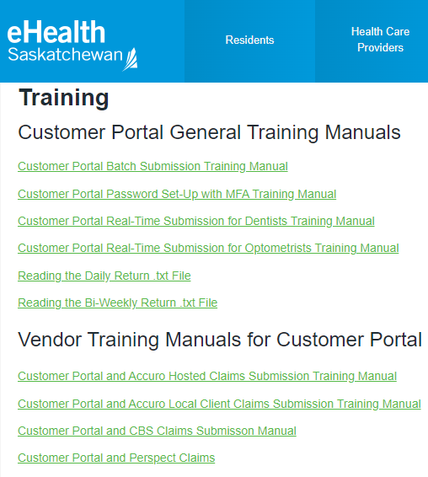
Training Tool Kit
www.ehealthsask.ca/services/CustomerPortal/Pages/Training.aspx
Notes:
Add link to chat window.

Slide 4
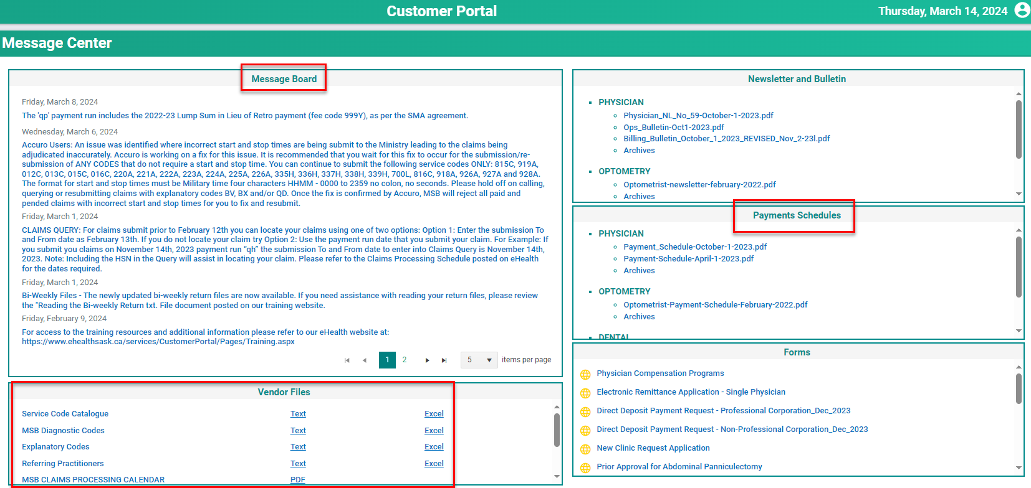
Customer Portal Home Page

Slide 5
Validation Report (CP)
Daily Return File (CP)
Bi-Weekly Return File (CP)
Accepted
Rejected
Only Rejected lines items from previous days submission.
Summary of all:
- Paid
- Pended
- Rejected
claims for the
bi-weekly period.

Slide 6
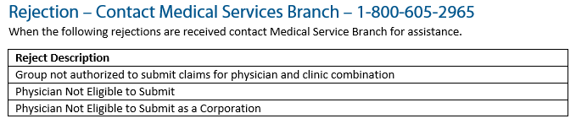
Validation Rejection Errors

Slide 7
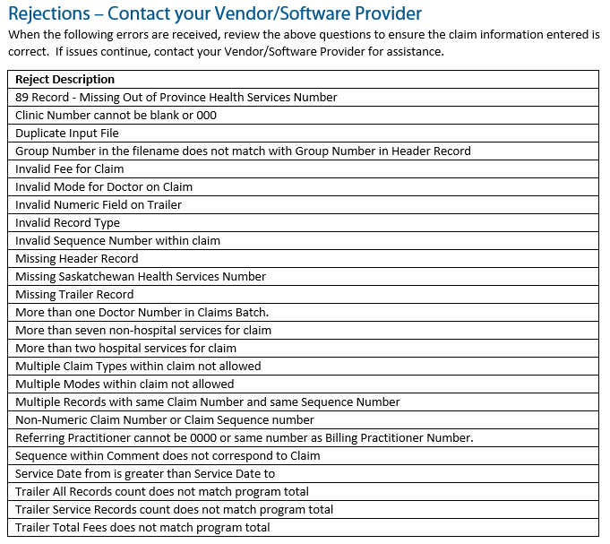
Validation Rejection Errors

Slide 8
Who’s Who in Your Group?
All active physicians in your group.
Any physician that has been part of your group (past or present).
Validation Reports, Daily Return Files and Bi-Weekly Return Files in CP will display validation reports for all physicians in your group.

Slide 9
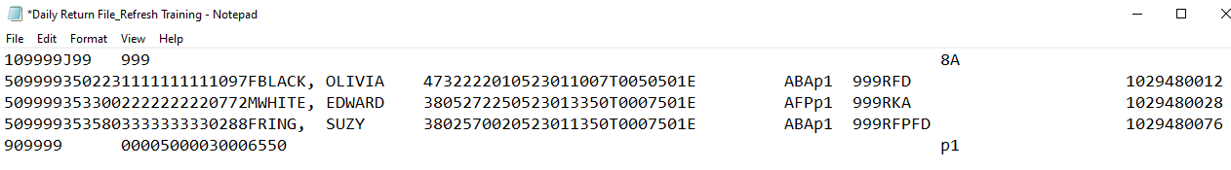
Reading Your Daily Return File

Slide 10
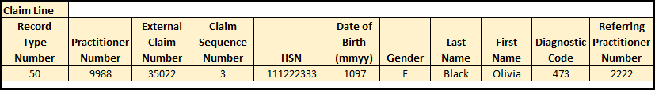
Reading Your Daily Return File

Slide 11
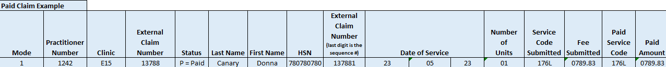
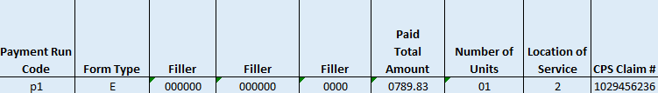
Reading Your Bi-Weekly Return File

Slide 12
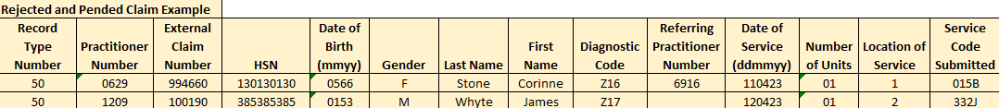

Reading Your Bi-Weekly Return File
Notes:
Go to Customer Portal – Daily Return File
How to read the Daily Return File
Prof Corp Indicator
Query a claim based off the Explan Code

Slide 13
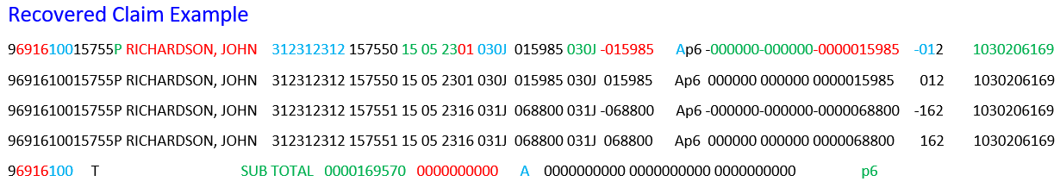
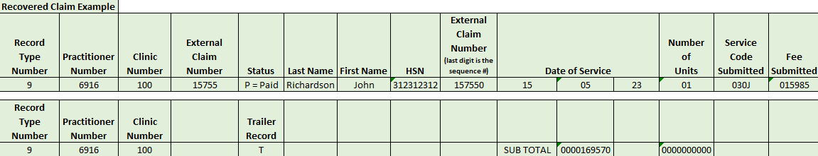
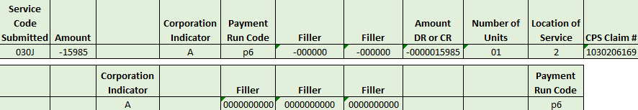

Slide 14
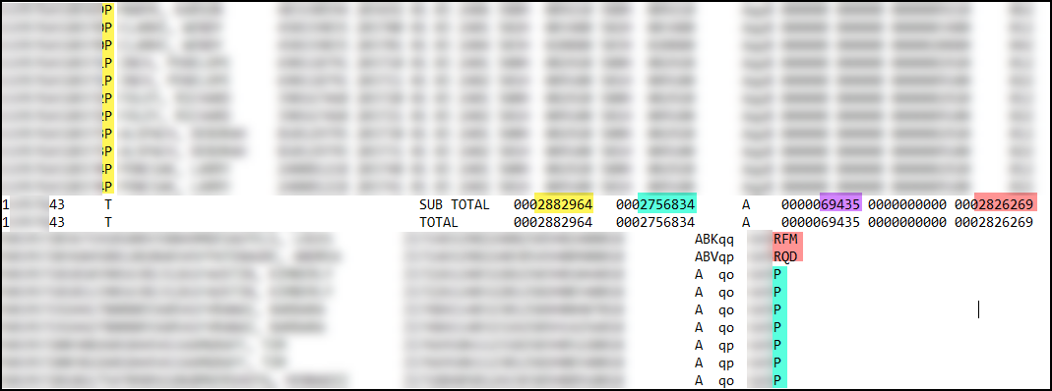
Reading Your Bi-Weekly Return File
Notes:
2882964 = Fee Submitted
2756834 = Fee Approved
69435 = Premiums
2826269 = Total paid = Fee Approved + Premiums

Slide 15
Query Claims
Rejected Claim
Explan Code (ie. AU)
Add attachment
Recovery of a Paid Claim
Billed in Error
Status of a Claim
Determine the status of a claim
Add a note
Rejects the claim
NOTE: Can’t recover a rejected claim.
Notes:
Go to Customer Portal – Query Claims – Demo
Rejected – requires changes/updates to claim data – fix in software and resubmit
Rejected – requires attachment, notes or additional information - query

Slide 16
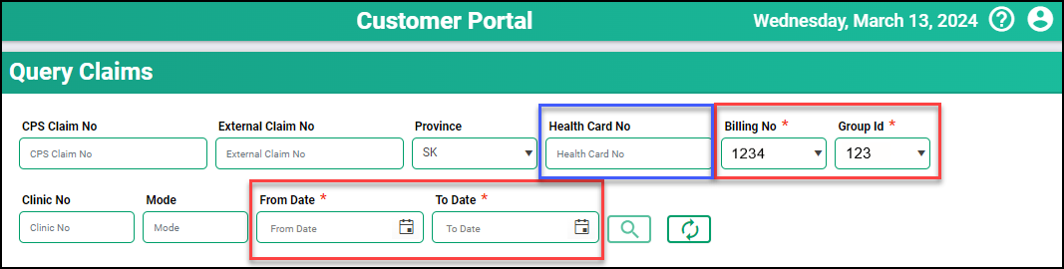
Key Fields to Query a Claim
Health Card No
Billing No and Group ID
To & From Date = Submission Dates

Slide 17
Submission Dates to Query a Claim
Submitted AFTER Feb 13
Use exact date of submission
Backlogged Claims Not Processed
Use February 13, 2024
Claims Processed in Old System
Use the payment run date of when your claim was submitted.
For Example: Submitted on November 14, 2023 (run qh), use November 14, 2023, as the submission date

Slide 18
Scenarios
Submission Does Not Match the Paid amount
Did you reconcile using your Bi-Weekly return file? All paid, pended and rejected are listed.
A line item without a paid amount or Explan Code has pended.
Pended claim is set for a manual review.
Claims may be:
  Paid at different amounts (higher/lower/75%)
  Claims rejected
  Claims paid with a premium
Notes:
Did you reconcile using your Bi-Weekly return file. View paid, pended and rejected.
If the line item does not have a paid amount or Explan Code it means it is pended.
Claims paid at different amounts (higher/lower) ie. 75%.
Claims submitted may have pended for manual review
Claims rejected
Claims pay with a premium

Slide 19
Scenarios
Pay List Does Not Match Amount Deposited
Were additional payments received?
  SMA payments
  EMR payments
Were any recoveries processed?
Have you reconciled your billings?
Call 1-800-605-2965 to log the issue.
Notes:
After checking on these items, all else fails, then call 1-800-605-2965 to log the issue.
Must do your due diligence.

Slide 20
Scenarios
Any ‘base’ & ‘add’ code or any code dependent on another code to be paid
If one of the service codes:
  PENDS
  And the other PAYS
Wait until ALL line items are adjudicated.
Notes:
In this scenario, we are waiting for all the necessary physicians to submit their claims. Once all are submitted our Claims Analysts will review the entire history for that HSN and pay or reject the claim accordingly. No action is required on your part at this time.

Slide 21
Scenarios
How to handle a rejected a claim?
Review the explan code
  1) Not payable – no action required. (ie. JN, BK).
  2) Query claim – to add a note or an attachment.
    AU – attach a document
    DM – add a note
  3) Update the claim in your software and re-submit the claim in your next batch
    submission (ie. ZA, YG ZC, ZM).
  4) Physician information does not match (ie. ZF, ZP). Call 1-800-605-2965 to log the issue.

Slide 22
Explanatory Codes
Non-Accuro Users:
BV/BX/QD –Time-based codes require the time to be entered using military time.
Accuro user: your Accuro team can support you with all time-based service codes.
Time-based Service Codes
Ensure units align with time.
Surgical Assist 30J/31J -- Assist = 1hr 15mins
  30J = 1hr – 1300-1400
  31J = 15mins – 1400-1415
**Watch the major portion thereof**
For Example:
Notes:
**Watch the major portion thereof**
Refer to your Payment Schedule - some codes are 15, 30, 45, 60 mins.

Slide 23
Explanatory Codes – Rejected Claims
The services involving emergency room coverage cannot be paid as:
1) The physician is not eligible to bill these codes;
2) Another physician has been paid for the same time period in this community;
3) The incorrect dummy HSN has been used for this community;
4) An incorrect clinic has been used for this community;
5) Another ICD code must be used for regular services provided to a beneficiary; or
6) An incorrect service code, day of the week or amount has been used.
Explan Code = AJ
Confirm all the above is correct.
Most common error is the demographics are incorrect.
First name must be ER COVERAGE.
Action Required
Notes:
Update the claim data in your software and re-submit the claim in your next batch submission.
The first name must be "ER Coverage", not Kipling, Hospital, or Emerg

Slide 24
Explanatory Codes
Duplicate--same physician--payment has been made for the same service provided on the same day.
Please check your records for a duplicate payment and only resubmit the claim if the service has not been previously submitted and paid.
Explan Code = BA
All history is recorded in the new Claims System.
Query the claim to check the status of it and then action accordingly.
Action Required
Notes:
Submitting an identical claim will always result in a duplicate.

Slide 25
Explanatory Codes
Payment based on the service code and related payment approved by the Ministry of Health.
Explan Code = BK
For example:
790A will reject BK, if it is billed with anything else on the same day.
As per the Payment Schedule, this service cannot be billed with anything else on the same day.
No further action is required.
Action Required

Slide 26
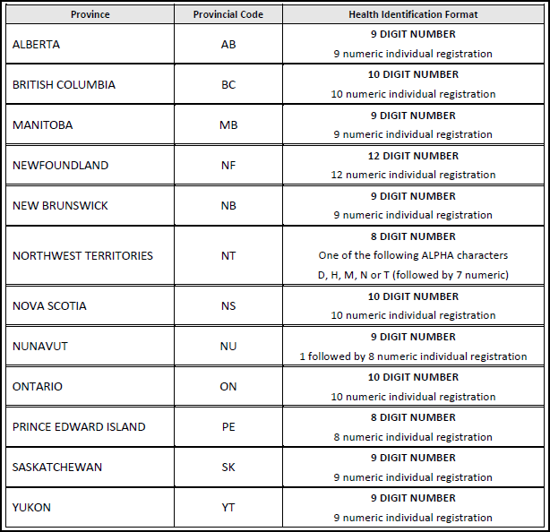
Explanatory Codes
The Out of Province registration number provided on your claim is not correct. Please check your records and modify the number, if incorrect. If the number is correct according to your records, please indicate this on the claim.
Explan Code = YG
Page 38 of Payment Schedule
Confirm Health Card is entered correctly.
Ensure correct Province code is used.
Blank is not allowed.
Action Required
Notes:
Update the claim in your software and re-submit the claim in your next batch submission.

Slide 27
Explanatory Codes
ZA – ZY Explan Codes
Demographic checks have been tightened.
Blank fields are not accepted.
All physicians on a claim must be active.
ICD9 Diagnostic Codes must be used.
Notes:
We have received several tickets regarding explan codes between ZA-ZY. As mentioned already, reading the description of the explan codes is critical as the description details what the issue is.

Slide 28
Explanatory Codes
Explan Code = ZA
Explan Code = ZC
The patient identity information on the claim (month or year of birth, sex or surname) does not correspond to information on the Health Services Card. Please check the Health Services Card, make the claim corrections and resubmit.
The submitted claim contains invalid data other than patient identification data, e.g. September 31, the submitted fee at zero dollars, the 13 month, a lower-case alpha character, a partially blank field as HSN, wrong location of service, a service not allowed for premiums etc.
Notes:
ZA - All patient information should be checked against PHRS – this is the source of truth.
ZC – Double-check the information keyed into the original claim to ensure all is correct.
Update the claim in your software and re-submit the claim in your next batch submission.

Slide 29
Explanatory Codes
Explan Code = ZF
Explan Code = ZL
Explan Code = ZS
The physician is not eligible to submit for services on the indicated dates of service.
The submitted referring physician number is invalid or an invalid referring physician number has been used for a non-cancer diagnosis or a nurse practitioner has referred to a physician that is not a specialist. Please check the referring physician name and number.
This claim was submitted as a Professional Corporation (PC) claim; however no PC information has been received or the PC claim is not valid on this date.
Notes:
ZF/ZL/ZS – All physicians on the claim, including referring practitioners, must be active physicians in MSB’s Physician Registry.
Double-check the data entered. If an update is required, make the change to the claim in your software and re-submit the claim in your next batch submission.
If it is correct, contact 1-800-605-2965 to log the issue.

Slide 30
Explanatory Codes
Explan Code = ZM
Explan Code = ZN
The claim contains an invalid diagnostic code according to the International Classification of Diseases - 9th Revision. Please check the diagnosis, diagnostic code and table of invalid codes.
The Ministry of Health has received multiple claims with the same clinic, physician, claim and Health Services Number. One of the claims is being processed; all other claims with the same claim number are being returned.
Notes:
ZM – Only ICD9 diagnostic codes are accepted. Update the claim in your software and re-submit the claim in your next batch submission.
ZN - Submitted the same item we have rejected. Refer to your original claim submission in Claims Query. Look at why original claim/items was rejected. Complete action required per explan code. For example: AU – attach docs to original claim. JN – not a payable claim/no action required.

Slide 31
Explanatory Codes
Explan Code = ZP
Explan Code = ZR
An invalid mode of payment or incorrect service code has been used on the claims or mixed services are being submitted for an APS claim (eg. 74A (SGI) and 5B or 600B)
The indicated location of service, service code or time is invalid for a premium payment on this date. (See "OUT OF HOURS PREMIUMS" section in Part A of this Payment Schedule).
Notes:
ZP –
Invalid Mode – if you’ve entered the mode correctly, contact 1-800-605-2965 to log the issue.
OR
If it is a claim with alternate payments, for example a claim that includes both, Mode 0 & 9 it will need to be entered as two separate claims (ie. Allied Health, SGI).
ZR - LOS, SC or Time invalid for premium pmt. For example, a non-prem LOS was entered when it should have been a premium LOS. Update the claim in your software and re-submit the claim in your next batch submission.

Slide 32

Training Resources
Validation Reports & Return Files
Group Information
Claim Queries
Scenarios and Explan Codes

Slide 33

Survey
A short 2-question survey will be coming your way.
We appreciate your responses.

Slide 34


Slide 35


