Slide 1
MySaskHealthRecord
2022-23 Enhancements
Open Clinical Documents
February 24, 2023

Slide 2
Agenda
Background/Governance
Current State & Benefits
Upcoming Enhancements
Next Steps
Questions

Slide 3
Background/Governance

Slide 4
History
Goal: Empower patients with information to become active participants in their care
2019: Approval to expand
2020: Released Covid-19 test results; Proof of Vaccinations Certificate
2018: Launched Pilot
(1000 users)
2021-Present: Additional features and data
2015: Partnered with Telus Health to build portal

Slide 5
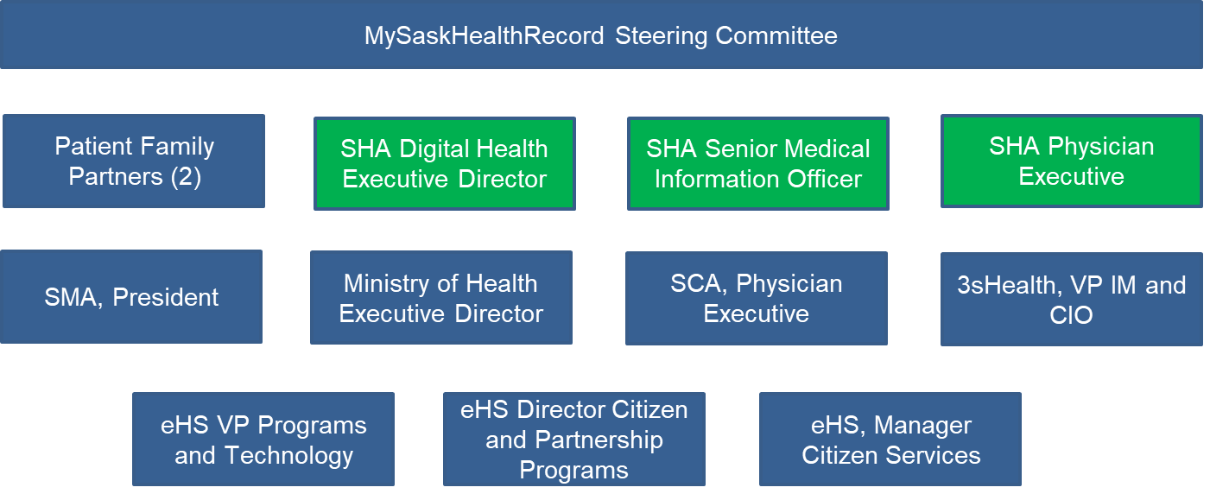
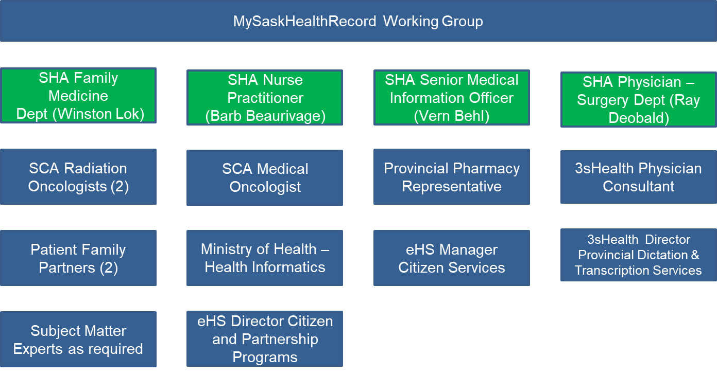
Governance
DM/CEO Council
Steering Committee
Working Group

Slide 6
Current State/Benefits

Slide 7
What is MySaskHealthRecords
MySaskHealthRecord is a free and secure website enabling patients to view their Health records, and manage their own health information
Launched in 2018, MySaskHealthRecord is currently available to patients 14 years and older. Parents and caregivers can also access health records for children and dependents under 14. Current users ~ 667K+
MySaskHealthRecord allows patients to:
View their Lab Results, Medical Imaging Reports, Immunization History, Prescription History and Clinical Visit History (three year of historical data is available)
Track and self document their health information

Slide 8
Benefits
MySaskHealthRecord Benefits | Results to Patients | Results to Health Care Providers
Increased access to relevant medical records | Improves patient engagement and encourages active participation | Active participation leading to improved health management
Increased ability to share records with health care providers and family members | Promotes transition and continuity of care | Improves continuity of care to make informed decisions Decreases time to access relevant patient medical records to support continuity of care
Increased ability to track personal medical information and appointments | Empowers patients to take an active role in their health management | Active participating leading to improved health management

Slide 9
Patient Feedback
In the 2020 MySaskHealthRecord user survey:
69% of users indicated they share their record with family or others who support their health care journey.
50% of users indicated they have noticed an improvement in the understanding of their health.
45% indicated and they are better prepared for their appointments and feel involved in managing their health in partnership with their health care providers.
40% of users’ indicated their stress levels have improved as a result of having access to their own information in MSHR.

Slide 10
Patient Outcomes

Slide 11
Upcoming Enhancements

Slide 12
Upcoming Enhancements (2022/2023)
Enhancement | Benefit for Patients
Launch Mobile App for MySaskHealthRecord | Anywhere access at their fingertips
Addition of new open clinical documents | Increase access to relevant clinical documents to promote patient participation Promotes transition and continuity of care

Slide 13
Open Clinical Documents

Slide 14
Open clinical documents: Scope
In scope (2023-24):
Documents generated in the SHA and SCA
Reports already in the eHRViewer:
Operative/Procedure
Discharge summaries/transfers
Patient consults/referrals
Review/Follow ups
Hospital Admission
Consults/Referrals
History/Physicals

Slide 15
Open clinical documents: Rollout approach
Phased implementation:
start small, not retroactive
Learn from other jurisdictions
Pilot with SCA
Formation of working groups to manage risks and change:
Corrections & Interpretation team
Sensitive information team
Change management and communication (CMC) team

Slide 16
Tentative Timelines
Timeline (pending DM/CEO approval)*
Phase | Estimated timeframe
Phase 1 – SCA reports | May 1 2023
Phase 2 – SHA prioritized reports | Q2-Q3 2023
* Timelines are dependent on DM/CEO approvals and organizational readiness.

Slide 17
Next Steps
Feedback and Questions

Slide 18
Ask
Learn about the portal. Information about MySaskHealthRecords is available on our website
Inform your team about MySaskHealthRecord
Provide feedback/Participate. Be part of our journey to empower patients

Slide 19
Questions?
Thank you!

